Slide 1
Retail Location Analytics (For L.L Bean)
By,
Dharmateja Priyadarshi Uddandarao

Slide 2
Table of content
Project Abstract
Deliverables
Project Outlines
Exploratory Analysis
Visualizations
Data Modelling
Predictive Analysis
Findings and Conclusions
Limitations of Analysis
References

Slide 3
Project Abstract
Hypothesis:
Offering a next perfect demographic location for L.L Bean which means to increase the brand value for L.L.Bean and profitable for the company
Conclusion:
Massachusetts is the best place to plan next L.L Bean store for next year due to its Brand awareness and increased Demand in the state.

Slide 4




Deliverables
Python
R
Tableau
Microsoft Power Point

Slide 5
Project outlines
L.L. Bean is a very popular retail industry in the east cost and developing it’s brand value in Other parts of USA.
Problem Statement:
Main problem statement for the project is to aim for a best next location to boost brand value along with increasing the company profits.
Project Goal:
Conduct a detailed exploratory and explanatory analysis to prove the hypothesis that any perfect location is that which will increases brand value along with profits.

Slide 6
Exploratory analysis and Data Visualization
Joined the buyers , sales , emails, catalogs, Promo sales by aggregate of Sum of each year for exploratory analysis and then cleaned the null values in the merged data to analyse the demand and customer count in different states and different years.
Outliers as preserved as the outliers might represent high sales days like thanksgiving or any other important day and might not be a real outlier value everytime.

Slide 7
Data Overview and description
Data set consist of many important attributes:
Customer count in Buyers
Demand in sales
Emails sent in Emails
Catalogs mailed in Catalogs
Promotional demands in promo_demand
Brand score in brand awareness
These are some high important attributes can be useful for our prediction

Slide 8
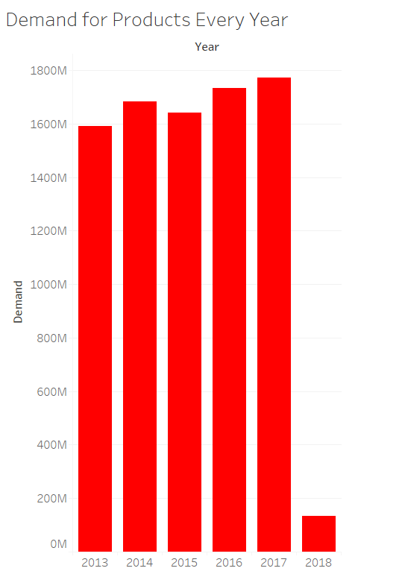
Demand for L.L.Bean products rise yearly
Yearly demand plot say that the demand for LL Bean products increasing every year in overall though there is a little fluctuation in 2015.
This rise in demand can be a good sign to forecast the brand value in future.
As the data of 2018 is incomplete it is not appropriate to consider 2018 for now in our current analysis

Slide 9
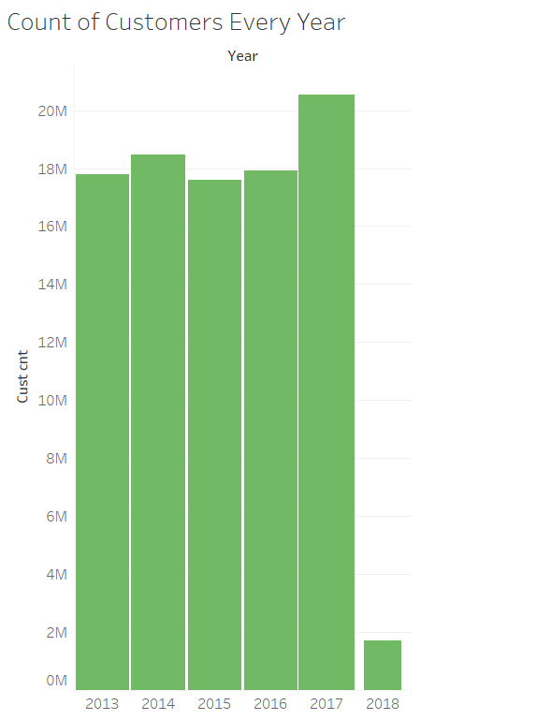
Customers fluctuate every year
This graph shows yearly unique customer count.
So this can say that brand awareness among customers is increasing in recent years but not that great up to 2016.
As the data of 2018 is incomplete it is not appropriate to consider 2018 for now in our current analysis

Slide 10
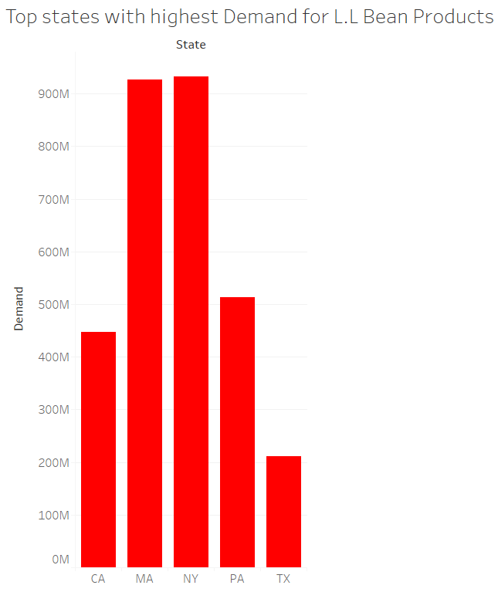
‘MA’ and ‘NY’ demands L.L.Bean
With help of Frequency table of sales in different states ,the top 5 states that create most impact on LL. Bean products demand can be inferred.
State wise demand plot say that the demand for LL Bean products is high in MA and NY.
This also says that brand awareness is more in these states and need to be improved in some other states

Slide 11
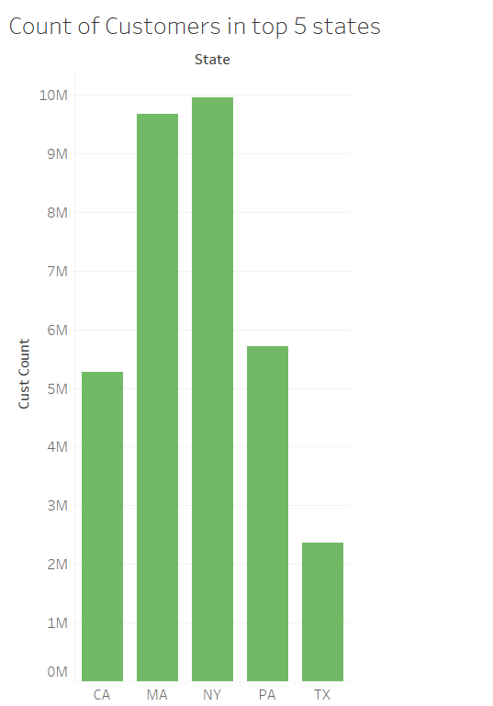
L.L Bean attracts customers in ‘MA’ and ‘NY’
This is the state wise unique customer count plot.
So this can say that brand awareness among customers is more in these states.
We should also consider population of states to know the brand awareness. But these states see more customers than other places
With this analysis , I can develop a predictive model to train the data given

Slide 12
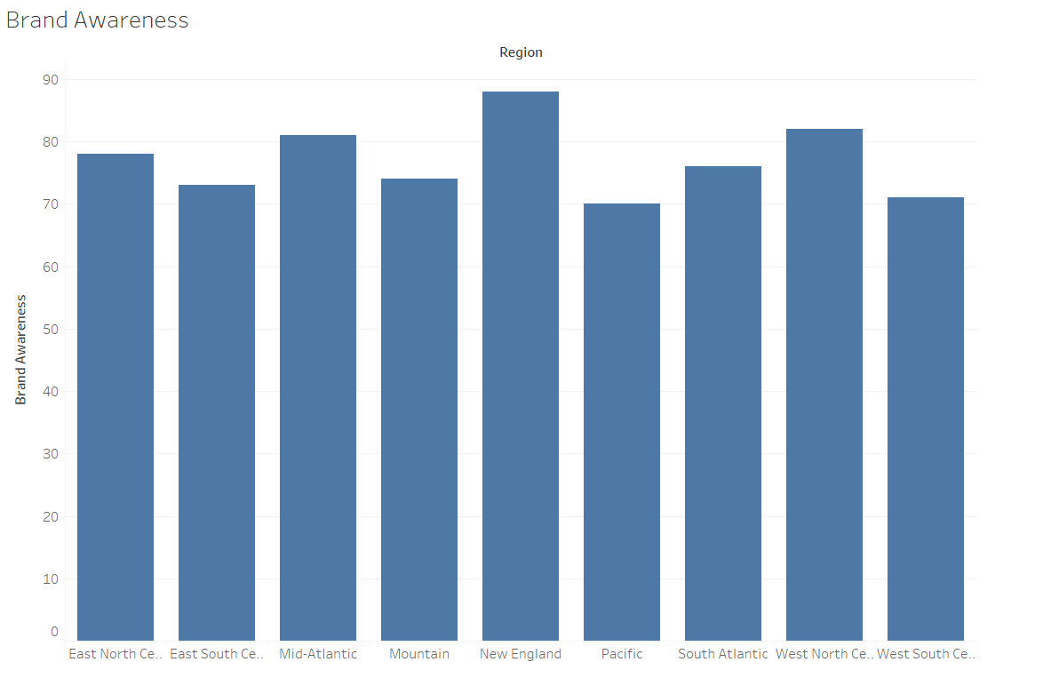
Massachusetts for brand
With the brand awareness scores we can easily infer that New England area has a god brand value. So it is not so early to say that Massachusetts is always a good spot for a new store after carefully looking into its demand and customers in the state.

Slide 13
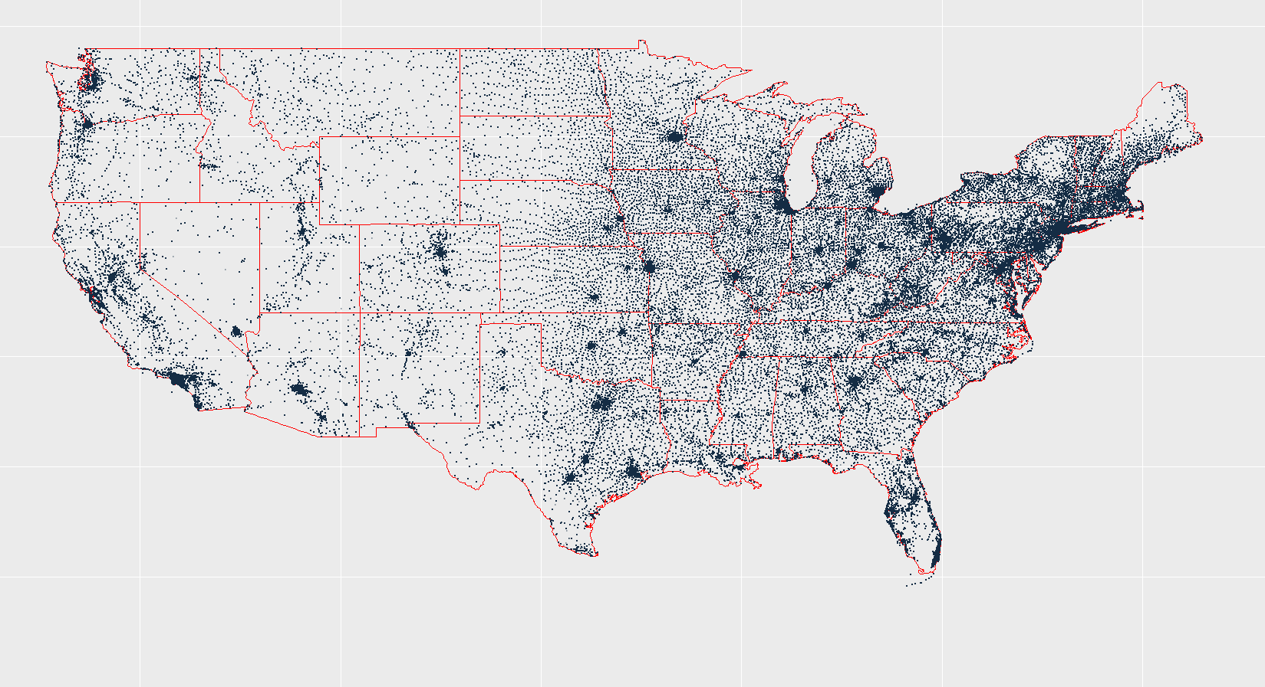
Demand for L.L Bean Products
The demand for L.L Bean Products is concentrated in east cost mainly in the states of New York, New Jersey, Massachusetts, Maine, Pennsylvania.
West cost also sees a good amount of demand but distributed widely.

Slide 14
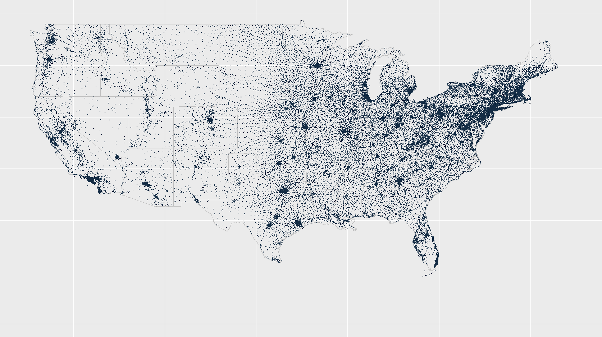
customers Density in us
The density of customers is mainly concentrated in east cost and mainly in the states of New York, New Jersey, Massachusetts, Maine, Pennsylvania.
West cost also sees a good amount of people but it is widely distributed.

Slide 15
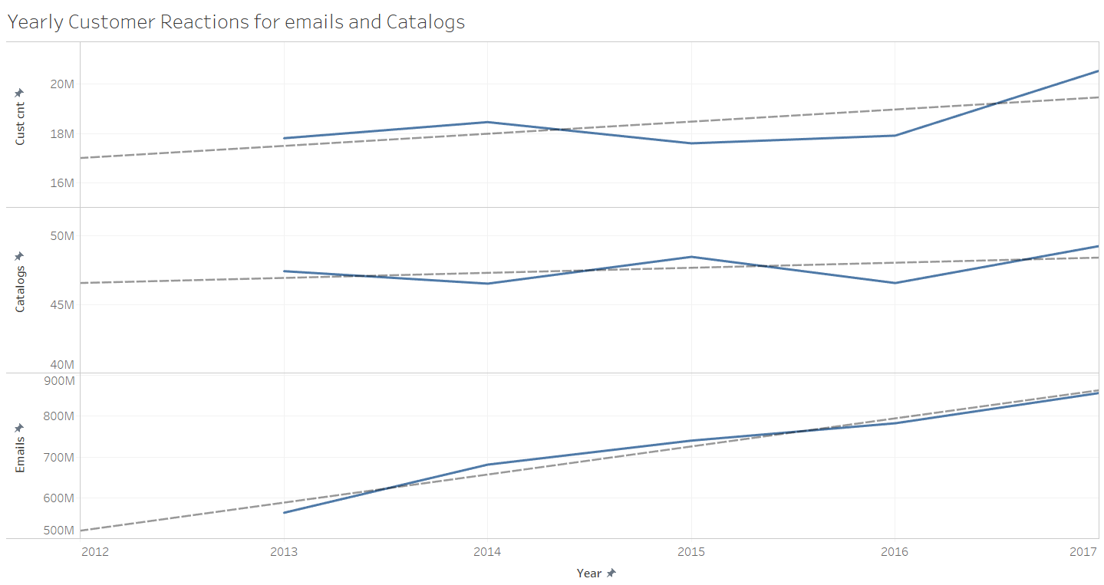
‘Emails and Catalogs Does Matter’

Slide 16
‘Emails and Catalogs Does Matter’
Emails sent and Catalogs mailed also make some difference in sales of product
As we see the trend lines, all the 3 are linearly increasing
Emails sent and catalogs mailed are directly proportional and these might also be a good predictors to determine the Demand

Slide 17
“Insights to Foresight”
With help of all above insights from exploratory analysis it is safe to conclude
Top 5 states with high demand and customers can be taken for analysis
Data from Buyers, Sales, Emails, Catalogs, Promotional demand can help us to predict the next best store location.
Exclude data for 2018 due to data insufficiency
MA holds a good brand value for L.L.Bean products in the top 5 demanding states.
West cost sees a wide distribution of customers and demand without much concentration in one place except few.

Slide 18
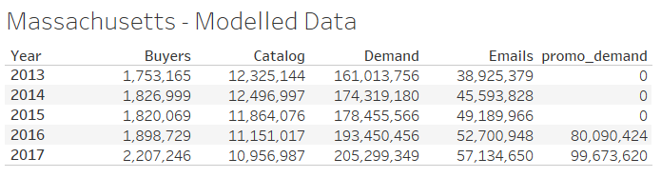
Data Modelling
The huge data which is considered for predictive analysis must be modelled with all the filters that are concluded before.
Each dataset(Buyers, Sales, Emails, Catalogs, Promotional demand) is filtered into 5 different datasets of top 5 states (MA, PA,TX, NY, CA)
In each state sum aggregate by year can be performed to get a yearly report for every state and all the predictor dataframes can be merged without 2018 data.
For Example, Massachusetts modelled data look like.

Slide 19
Model to Module
Promotional demand data is not present for years before 2015 but still it is a good predictor from 2015 after looking into results of regression model.
We get the data modelled for all the top states( MA, PA, NY, CA, TX) with high demand and sales.
This reduced model is a foundation stone for the predictive algorithm.

Slide 20
‘Get the model right and right model to get’
It is very clear that any next store planned should locate at a place with high demand.
Forecast 2018 and 2019 with past year statistics to understand future scores.
With all the top States reduced model in hand it is very important to get a right model to predict the best future store.
With help of other predictors, demand in 2019 can be predicted for each state and get the state with high demand

Slide 21
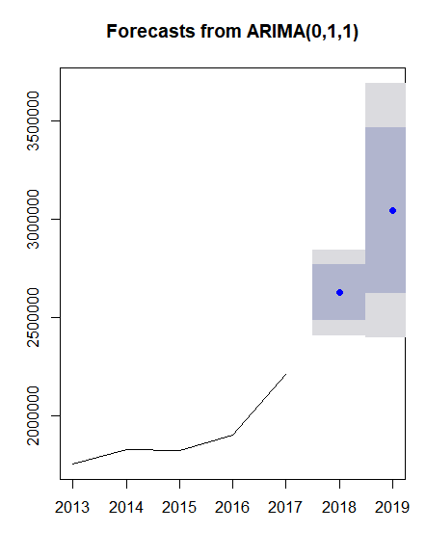
‘Forecast to foresee’
For the complete model:
Predictors : Buyers, Catalog, Emails, Promotional Demand
ARIMA model can be used to forecast the predictors which can be further used to predict the demand for each state.
This Timeseries model is applied with 87% accuracy.
The side graph is example for the ARIMA predicted data points for 2018 and 2019 Buyers of Massachusetts.
ARIMA can be applied for all predictors to fill the values for 2018 and 2019.

Slide 22
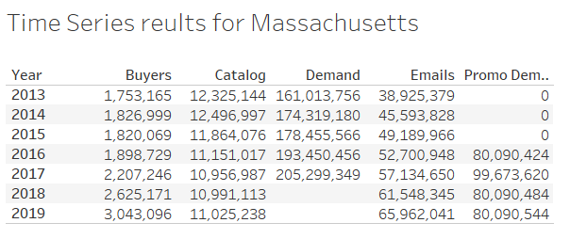
Time-series…..
Results for Massachusetts after applying timeseries on Predictors
Every state is modelled to get 2018 and 2019 values for predictors.
Unfilled Demand can be calculated by training all the predictors against the demand.

Slide 23
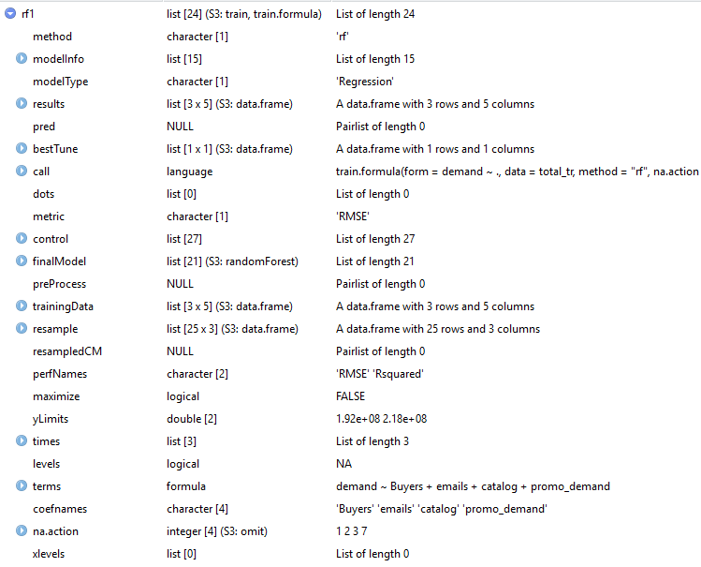
‘Random Forest for Retail Forest’
Now that all predictors are completely filled, Random forest algorithm can predict the demand for L.L Bean Products for 2019 in the States chosen.
Random forest can be trained with ntree = 50 to avoid over fitting of data with less records.
It is very important to train the data set taking most of the parameters into consideration because it can help in increase accuracy

Slide 24
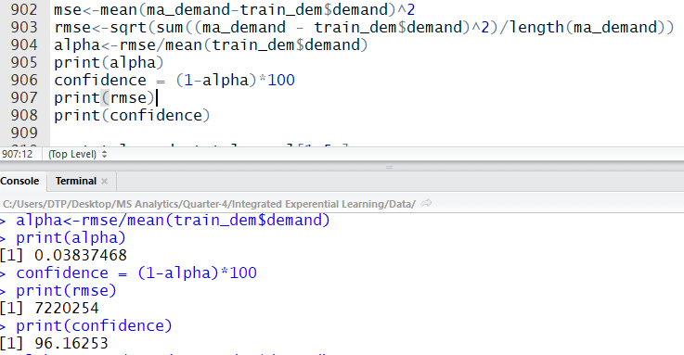
Analyse Confidence for Confident Analysis
Root Mean Square Error (RMSE) is important to interpret the model.
The model developed notes
RMSE : 7220254
Confidence : 96%
This is a very good confidence level to rely on.

Slide 25
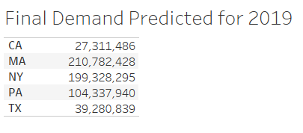
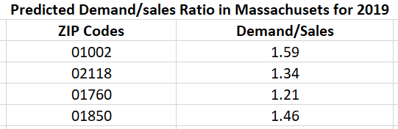
Findings and conclusions
Final demand for top 5 states in 2019 is as shown in the table.
We can clearly notice that Massachusetts and New York are going to see a high demand for L.L Bean products next year.
Let us short down a best state considering various factors further to MA.
Demand to sales in top 4 Zip codes predicted to be Amherst, Natick, Lowell, Boston.
Seeing the high demand to sales ratio, Amherst is the best location to open a new store.

Slide 26
Here you go
With all the analysis put together
MA and NY are the places to have high demand for L.L Bean products next year.
Sales are seen to increase drastically in these areas.
Both MA and NY has similar climate and which L.L Bean products see a great demand
As we see the brand awareness is very high in New England which is concentrated in Massachusetts.
Density of buyers is very high in MA as compared to Population density of MA(893 people per sq.mile) and attracting more customers is evident.
Massachusetts is definitely a great place to plan for next L.L Bean Retail store

Slide 27
Future Considerations
L.L Bean see a great demand in west coast but the purchasing capacity is widely distributed for the complete coast.
CA sees a good amount of customers to even with less outlets compared to other states.
So, L.L Bean must work to increase the Brand value in CA by exporting to more products into local retail stores to increase the customer density in the state.
As the manufacturing unit is in east cost which is very far, it is not much profitable to establish a far away outlet in CA unless a good amount of density in buyers is observed at a place.
Widely spread customers in a state cannot guarantee to get good profits as the travel time for customers also matters for their decision to buy.
So, Exporting L.L Bean products in more number to some very densely populated cities can help L.L Bean establish a profitable store in west coast and further a new manufacturing plant can be planned for west and central states.

Slide 28
Limitations of analysis
The analysis performed has taken data from time frame of 2013 to 2018 into consideration.
The analysis performed has taken promotional demand from 2015 due to lack of data.
Complete analysis only includes the data provided under L.L Bean NDA and some external data, where as there are far more attributes can be considered for location analytics in detail.
Due to some incomplete values(NA’s) , some of the data have been removed, which might sometimes be important if the original data is considered.

Slide 29
References
Exploratory Analysis – When to Choose R, Python, Tableau or a Combination. (2018, March 12). Retrieved from https://www.r-bloggers.com/exploratory-analysis-when-to-choose-r-python-tableau-or-a-combination/
Kabacoff, R. (n.d.). Axes and Text. Retrieved from https://www.statmethods.net/advgraphs/axes.html
Calculating Consumer and Producer Surplus. (n.d.). Retrieved from https://obliviousinvestor.com/consumer-and-producer-surplus/
Mercurio, J., (1984) Store Location and Store Assessment Research, John Willey & Sons, Ltd., New York.). https://dc.uwm.edu/cgi/viewcontent.cgi?article=1683&context=etd
D. L. Huff. A probabilistic analysis of shopping center trade areas. https://www.esri.com/library/whitepapers/pdfs/calibrating-huff-model.pdf

Slide 30
References
D. L. Huff. Defining and estimating a trading area https://www.jstor.org/stable/1249154?origin=crossref&seq=1#page_scan_tab_contents
G. Löffler. Market areas - a methodological reflection on their boundaries. https://link.springer.com/article/10.1023%2FA%3A1006980420829
Developing a location research methodology https://link.springer.com/content/pdf/10.1057/palgrave.jt.5740146.pdf
IndustryARC(2017) Location Intelligence & Location Analytics https://www.prnewswire.com/news-releases/location-intelligence--location-analytics-market-expected-to-reach-1643-billion-usd-by-2021---industryarc-research-641375383.html

